Slide 1
Application Software
Mr Butler | AS2

Slide 2
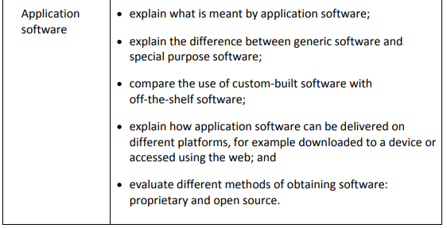

Slide 3
What is application software?
A software application carries out tasks that the user is interested in doing such as writing a letter, creating graphs, sending an email or downloading a webpage.
Software applications work through the operating system to gain access to the hardware.
Application software is designed to enable an end-user complete a specific type of task.
Application software can be classified under two main categories:
  General purpose software
  Tailor made (bespoke software)

Slide 4
General Purpose Software
A general purpose application, sometimes known as ‘off-the-shelf’ is the sort of software that you use at home and school. Examples include word processors, spreadsheets, databases, desktop publishing packages, graphics packages etc.
This type of software tries to be a ‘jack-of-all-trades’. It provides many features that the majority of users will want e.g. formatting text, creating charts, organising tables. But it does try to be’ all things to all people’ and so there will be a vast number of features that you may never use e.g. statistical functions, mail merge. This makes the storage size of these applications fairly large.

Slide 5
TASK: Describe 4 advantages for using Generic software

Slide 6
The benefits:
It is relatively cheap - reduced cost as development costs are shared across many users.
It is easily available from most computer shops, so is widely available
It will have been thoroughly tested so there won’t be any serious problems or bugs
There will be lots of user support i.e. books, user guides, online help and discussion forums on the Internet
Less training required – its functionality is similar to other systems and most tools use the same icons/etc with the same output.

Slide 7
Examples of Off-the Shelf Application Software
Word processing application - writing reports, memos, letters to customers
Spreadsheet application - keeping simple company accounts, calculating employee commission payments, simple stock control system, modelling
Database application - keeping customer records, sales records, appointments system
Desktop publishing application - creating leaflets, posters, business cards
Presentation software - creating presentations to show to customers or staff
Graphics application - manipulating images that can be used at home, school or a business
Web design application - creating personal or business websites

Slide 8
Bespoke Software
Although most organisations use general purpose software, some organisations will find that it just doesn’t do exactly what they want or it doesn’t work with their current systems.
In this case, they might decide to have the software system they need designed and developed specifically for them.
This is called ‘tailor-made’ or ‘bespoke’ software.

Slide 9
TASK: Describe 4 advantages for using Bespoke software

Slide 10
The benefits:
the company will get the exact software/system that they need
the software will work exactly how they want it to work
the software will only have the features that they specifically need in their business.
User requirements will be met in full. For example, software will work exactly the way the user needs it to work. In addition, no unnecessary or unwanted additional features will be included in the application

Slide 11
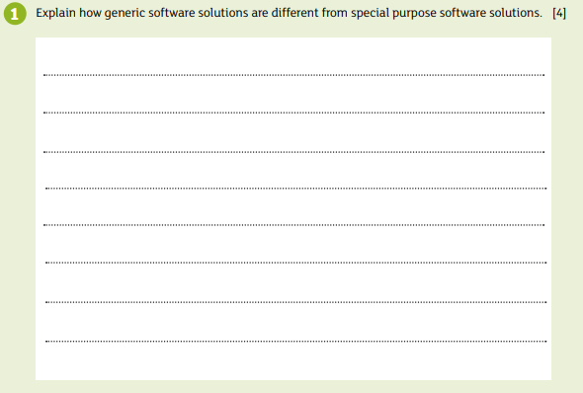

Slide 12
The disadvantages of Off-the shelf Software
The user interface may be unnecessarily complex because it may contain a lot of additional features the organisation does not need.
May not meet all the organisations requirements.
Users’ approach to completing tasks using the new system may have to be amended.

Slide 13
The disadvantages of Bespoke Software
What, then, are the disadvantages of using bespoke software? Why don’t we use this everyday?
There are several reasons:
  Will take a long time to develop from analysis through to implementation.
  Increased costs as there is a need to employ a specialist team to produce the solution.
  Less support freely available

Slide 14
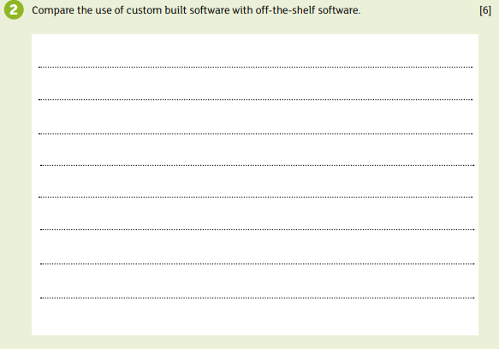

Slide 15
Fact File 2: Mark Scheme
The user requirements of the application are met in full in custom-built software[1]
Off the shelf software will contain a lot of additional features which are not required, making it overly-complex [1]
Custom-built software incurs increased costs [1] due to the company requiring to pay for its development
Off the shelf software is relatively cheaper [1] as development costs are shared throughout a larger audience
Special purpose software is designed for a specific application/task [1]
Generic software performs general tasks and is not limited to one particular application [1]
… and hence the software may not meet the exact user requirements [1]

Slide 16
Research Task: Software Delivery
Research how application software can be delivered on different platforms.
  Internet?
    Direct Download / torrent (peer-to-peer) download
    Stream the software on the internet? (i.e. word online / pixlr online / etc?)
    Disk Installation
  What is the process of installation?
  How can the software then interact with the physical hardware of the PC?

Slide 17
Software Delivery
Many applications are now distributed to users via the internet.
This allows the distributor to by-pass retailers and the physical distribution process and allows the delivery of applications directly to the user.
Content distributed electronically may be accessed using the internet (streaming) or it can be downloaded for use on a supporting hardware device to allow off-line access at a later stage.
Online versions may also be available.

Slide 18
Both approaches have their pros and cons.
By downloading an application for use on an electronic device the user is guaranteed access to that application at any time.
Access is not dependent upon them have an appropriate broadband link the next time they wish to access the product, the downside however is the fact that the application will require space on the devices backing storage device.
Consideration also needs to be given to the fact that without an appropriate backup, damage to the storage media or device housing the application may result in the user losing data or applications.

Slide 19
Where an end user opts to store a data file or an application on the internet little consideration needs to be given to the storage capacity of the accessing device.
The user simply needs to ensure they have an appropriate broadband line available to them each time they wish to access the application.
This dependency on a telecommunications means obviously that any issues with the user’s broadband can impact upon the availability of the application.
The application is only available to the user when they are online. Where a user is accessing an application online they can be guaranteed access to the most up-to-date version of that application each time they use it.
All updates are applied directly to the application are readily available to all users.

Slide 20
Users who are accessing digital content online can access the applications they own the licensing rights to using any compatible device by logging into their content server.
  In essence they can access the same application on multiple devices, make amendments on any device and remain secure in the knowledge that their amendments will be synchronised and stored online for later access.
  In instances where a user has downloaded an application for use offline, they may not initially be aware of the availability of any updates, and this will only be made available to them following further downloads.

Slide 21
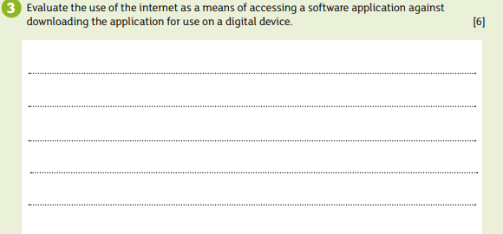

Slide 22
Propriety or Open Source Software?
Proprietary software is software where someone (normally the owner or creator) retains the rights to for example the source code for the application.
Proprietary software is copyright protected and there are limits imposed upon its use, distribution and modification.
In essence the person, team or organisation responsible for the development of the application in this instance maintains exclusive control over it.
Only the original authors of the application have the legal right to copy the application, view the source code or make any form of modification.
Subsequent users must sign a license agreement to show they agree to only use the application within the bounds originally set down by the applications original authors.

Slide 23
Open source software on the other hand is software which has its source code made readily available to other users for editing and redistribution.
As with proprietary software there is still a licence associated with the application but in this instance it generally grants the users permission to use the application for any purpose they wish.
More often than not the license associated with open source software will state that any modifications should be made available to other users alongside the original code and redistributed without charge.

Slide 24
Proprietary
  + Regular updates
  + Support readily available
  - Bug fixes may be slow
  - Security updates may be slow
  - Help only available at specific time (work hours)
Open Source
  + Fast fixes to bugs
  + No-cost
  + Multiple versions of application available to chose from
  + Wide range of support during the life-span of the package
  - Too many versions available to chose from – how do you know which is best for you?
  - Help may not always be available

Slide 25
Task: Questions 4-6 of Fact File
4. Clients wishing to obtain a software solution to a given problem can opt for proprietary software or open source software solutions. Explain the difference between proprietary software and open source software. [6]
5. A small local business wishes to introduce a software solution to help with the management of customer orders. They are unsure if a proprietary solution or an open source solution is most appropriate for them. Which solution would you recommend? Explain why this is the most appropriate solution for them. [6]
6. Identify the pros and cons of a proprietary software solution. [6]

Slide 26
Fact File 3 Mark Scheme
Accessing Applications via internet:
+ little consideration needs to be given for storage capacity of device
+ only consideration is that adequate broadband connection is available
+ Most up to date application with all features it includes
+ Updates occur as soon as they are available
+ Users can access/edit the same documents from different devices and all changes are synchronised to all devices
- Dependency on communications/ broadband outages will affect connection and availability
- Hence applications are only available when online.
Downloading Applications:
+ Guaranteed access to the application
+ Not dependant on user having an appropriate broadband link
- Requires additional storage space
- devices can be more expensive for large memory capacities
- Without backup, damage to device may result in loss of data/applications
- Applications offline may not be initially updated and may only be available if further downloads take place

Slide 27
Fact File 4 Mark Scheme
Proprietary software is software where somebody retains the rights to source code [1]
… for the application and cannot be changed or edited without permission [1]
Proprietary software incurs a cost to the user [1]
Open source software for which the copyright to source code are in the public domain [1]
No licence is required to use the code [1]
.. And is freely available [1]
Users can change or improve the software and redistribute [1]

Slide 28
Fact File 5 Mark Scheme
Proprietary software would be recommended [1]
As there are regular updates [1]
…with support readily available [1]
It will also be well tested [1]
And deemed more secure due to this [1]
Open source software will have multiple versions which would be significantly understested [1]
And may have security flaws [1]

Slide 29
Fact File 6 Mark Scheme
  + Regular updates [1]
  + Support readily available [1]
  + Well tested [1]
  - Bug fixes may be slow [1]
  - Security updates may be slow [1]
  - Help only available at specific time (work hours) [1]
  - Incurs a cost to the user (so is more expensive) [1]

Slide 30
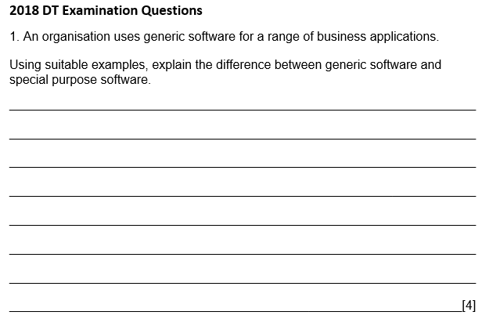
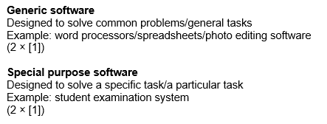

Slide 31
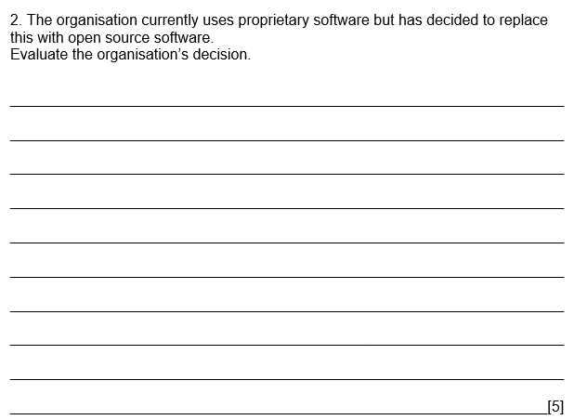
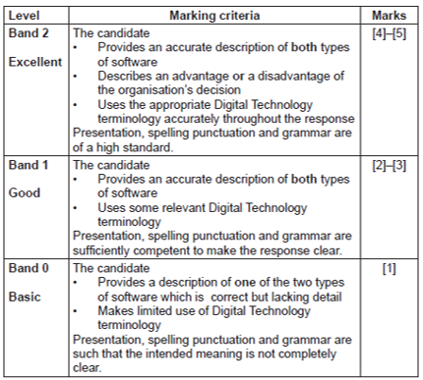
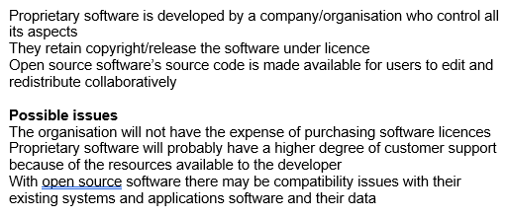

Slide 32
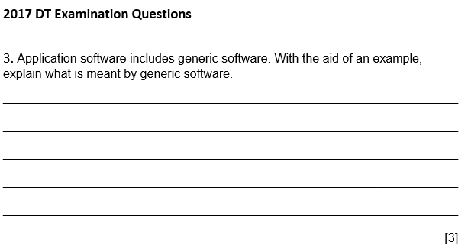


Slide 33
